Slide 1
Undetectable = Untransmittable
(U = U)

Slide 2
U=U: Building the evidence
The evidence, experience and expert opinion to support the U=U message has been increasing over two decades¹
Viral load is the single biggest determinant of HIV transmission risk^{1,2}
The Partner study was the ‘tipping point’ in our understanding and our approach to messaging²
The results of Partner 2 gave us the confidence to be definitive about the messaging and language around U=U³
U=U taking off in 2017. Editorial Lancet HIV 2017;4(11):e475;
Rodger AJ et al. JAMA 2016;316(2):171–81
Rodger AJ et al. HIV transmission risk through condomless sex in gay couples with suppressive ART: The PARTNER2 Study extended results in gay men. IAS 2018

Slide 3
U=U: Building the evidence
Rakai study of 415 HIV serodifferent heterosexual couples in Uganda
35
All subjects
Male-to-female
transmission
Female-to-Male
transmission
30
25
20
Transmission rate per 100 person-years
15
10
5
0
<400
400–3,499
3,500–9,999
10,000–49,999
≥50,000
<400
400–3,499
3,500–9,999
10,000–49,999
≥50,000
<400
400–3,499
3,500–9,999
10,000–49,999
≥50,000
HIV-1 RNA (copies/ml)
No cases of transmission to sexual partners observed for patients with VL <1,500 copies/mL
RNA, ribonucleic acid; VL, viral load.
Quinn TC et al. N Engl J Med 2000;342:921–9.
Notes:
Rakai study in Uganda – 20 years ago – demonstrated the intimate link between VL and transmission risk. The higher the viral load the greater the risk of transmission – and conversely the lower the viral the smaller the risk of transmission – with no transmissions where VL < 1,500 copies/mL. The question remained – is there a viral load low enough to confidently state that transmission will not occur?

Slide 4
U=U: Building the evidence
HPTN 052: Study design
Stable, healthy, HIV serodifferent, sexually active couples
CD4 count: 350–550 cells/mm³
Randomisation
Immediate ART
CD4 350–550 cells/mm³
Delayed ART
Initiated when CD4 ≤250 cells/mm³
Primary transmission endpoint
Virologically-linked transmission events
Primary clinical endpoint
WHO stage 4 clinical events, pulmonary tuberculosis, severe bacterial infection and/or death
ART, antiretroviral therapy; CD4, cluster of differentiation 4; HPTN, HIV Prevention Trials Network; WHO, World Health Organization.
Cohen MS et al. NEJM 2011;365:493–505.
Notes:
HPTN052 – significant study. Randomly assigned sero-different couples to positive partner starting treatment immediately (CD4 350 – 550) or to defer until CD4 count 250 (standard of care at the time)

Slide 5
U=U: Building the evidence
Total HIV-1 transmission events: 78
Linked transmissions: 46
Unlinked transmissions: 26
93% reduction in
HIV transmission
Hazard Ratio 0.07% (0.02 – 0.22)
P<0.05
Delayed ART: 43
Immediate ART: 3
Antretroviral Therapy for the Prevention of HIV-1 Transmission
Cohen MS et al. N Engl J Med 2016; 375:830-839

Slide 6
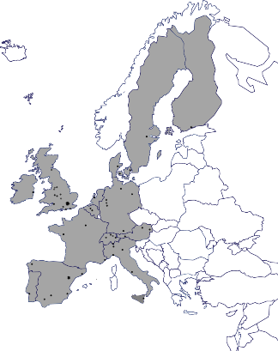
U=U: Building the evidence
Partner Study
Design:
888 HIV serodifferent couples
(548 heterosexual and 340 MSM)
HIV-positive partner on ART with a viral load <200 copies/mL
75 European clinical sites
Primary aim:
To study the risk of HIV transmission through anal and vaginal sex in the absence of condom use for people with an undetectable viral load
ART, antiretroviral therapy; MSM, men who have sex with men
Rodger AJ et al. JAMA 2016;316(2):171–81.
Notes:
Partner study – outline of study design and primary aim

Slide 7


U=U: Building the evidence
Partner Study: Results
1,238
eligible CYFU
58,000
condomless sex acts
11 of the initially HIV-negative partners became HIV-1 infected
ZERO
transmissions linked to their HIV positive partner
8 (73%)
reported recent condomless
sex with others apart from
their study partner
18%
6%
Overall transmission risk was zero (95% CI 0–0.3/100 CYFU)
of MSM and
of heterosexuals reported STIs
CI, confidence interval; CYFU, couple years of follow-up; MSM, men who have sex with men; STI, sexually transmitted infection.
Rodger AJ et al. JAMA 2016;316(2):171–81.

Slide 8
U=U: Building the evidence
Partner Study: Rate of HIV transmission according to sexual behaviour reported by the HIV- partner (All couples)
% of eligible
couples reporting specific sex act
Couple-years of follow-up
Any sex | 99.7 | 1,238
Vaginal sex | 60.6 | 629
Anal sex | 52.9 | 522
Insertive anal sex | 42.1 | 417
Receptive anal sex with ejaculation | 21.4 | 166
0
1
2
3
4
Rate of within-couple transmission, per 100 couple-years of follow-up
Rodger AJ et al. JAMA 2016;316(2):171–81.
Notes:
HIV transmission risks – varying confidence intervals which is determined by the number of couples years of follow-up

Slide 9
U=U: Building the evidence
Partner Study: Rate of HIV transmission according to sexual behaviour reported by the HIV- partner (All couples)
% of eligible
couples reporting specific sex act
Couple-years of follow-up
Upper 95% confidence limit
Any sex | 99.7 | 1,238 |  | 0.30
Vaginal sex | 60.6 | 629 |  | 0.59
Anal sex | 52.9 | 522 |  | 0.71
Insertive anal sex | 42.1 | 417 |  | 0.88
Receptive anal sex with ejaculation | 21.4 | 166 |  | 2.23
0
1
2
3
4
Rate of within-couple transmission, per 100 couple-years of follow-up
Rodger AJ et al. JAMA 2016;316(2):171–81.
Notes:
HIV transmission risks – varying confidence intervals which is determined by the number of couples years of follow-up

Slide 10
U=U: Building the evidence
Partner 2 Study
Design:
972 HIV serodifferent MSM couples
783 couples contributed to the analysis
HIV-positive partner on ART with a viral load <200 copies/mL
Primary aim:
To follow serodifferent partnerships that have penetrative sex without using condoms where the HIV-positive partner is on ART with a plasma HIV-1 RNA load <200 copies/mL to study risk of HIV transmission through anal sex in the absence of condom use
ART, antiretroviral therapy; MSM, men who have sex with men.
Rodger AJ et al. Risk of HIV transmission through condomless sex in serodifferent gay couples with the HIV-positive partner taking suppressive antiretroviral therapy (PARTNER): final results of a multicentre, prospective, observational study. Lancet 2019 Jun 15;393(10189):2428-2438
Notes:
Partner study – outline of study design and primary aim

Slide 11

U=U: Building the evidence
Partner 2 Study: Results
1,596
eligible CYFU
77,000
condomless sex acts
15 of the initially HIV-negative partners became HIV-1 infected
ZERO
transmissions linked to their HIV positive partner
11 (73%)
reported recent condomless
sex with others apart from
their study partner
18%
27%
Overall transmission for MSM in Partner 1 and 2 was zero
(95% CI 0–0.23/100 CYFU)
of HIV -ve partners and
of HIV +ve partners
reported STIs
CI, confidence interval; CYFU, couple years of follow-up; MSM, men who have sex with men; STI, sexually transmitted infection.
Rodger AJ et al. Risk of HIV transmission through condomless sex in serodifferent gay couples with the HIV-positive partner taking suppressive antiretroviral therapy (PARTNER): final results of a multicentre, prospective, observational study. Lancet 2019 Jun 15;393(10189):2428-2438

Slide 12
Why this is important
Removes the shame and fear of sexual transmission
Simplifies the possibility for conception
Changes the approach to HIV criminalisation
Tackles HIV stigma
Encourages people to test, engage in care and to start and stay on treatment^{1,2}
Author’s opinion.
Okoli et al Undetectable equals untransmittable (U = U): awareness and associations with health outcomes among people living with HIV in 25 countries. Sexually Transmitted Infections 2021;97:18-26.
Smith P et al Undetectable = Untransmittable (U = U) Messaging Increases Uptake of HIV Testing Among Men: Results from a Pilot Cluster Randomized Trial
AIDS and Behavior . https://doi.org/10.1007/s10461-021-03284-y

Slide 13
2019 Positive Perspectives Survey
Improving communication and engagement
with patients
Exploration of associations with indicators of quality of life and Patient Reported Outcomes (PROs) among People living with HIV (N=2389)
Relationship Between Engagement in Care and PROs
Adjusted Odds Ratio (95% CI) for exposed vs not to HCP behavior
Proportion Informed of U=U by HCPs, by Country
Specific HCP Behavior | Patient-reported Outcome | Adjusted Odds Ratio*
Provides enough information | Patients feels knowledgeable about HIV | 5.9 (4.9-.7.2)
Asks about ART side effects | Patients report that their treatment needs are met | 4.6 (3.8-5.6)
Seeks patients view on treatment |  | 4.5 (3.7-5.5)
Discusses new treatment options |  | 4.3 (3.6-5.2)
Inquires about treatment concerns |  | 3.7 (3.1-4.5)
Informed patient of “U=U” |  | 2.9 (2.4-3.5)
i
?
U=U
* Logistic regression models controlled for gender, sexual orientation, age, duration of disease, comorbidities, region, and education. Values indicated with confidence intervals (CL)
Improving quality of communication between People living with HIV and Healthcare Professionals may better support improved quality of life
*Odds of PRO based on exposure vs no exposure to HCP behavior
HCPs, healthcare providers
Okoli et al Undetectable equals untransmittable (U = U): awareness and associations with health outcomes among people living with HIV in 25 countries. Sexually Transmitted Infections 2021;97:18-26

Slide 14
U=U Information-Sharing by Healthcare Providers
2019 Positive Perspectives Survey
Cross-country analysis to investigate association of proportion of people living with HIV informed of U=U by HCPs with PROs
(April 2019-January 2020; N=2389)
Told of U=U by HCP (N=1588) Not told of U=U by HCP (N=801)
People living with HIV, %
People living with HIV who reported being informed of U=U by HCPs were more likely to report favourable PROs (all P<0.001)
PRO, patient-reported outcomes
Okoli et al Undetectable equals untransmittable (U = U): awareness and associations with health outcomes among people living with HIV in 25 countries. Sexually Transmitted Infections 2021;97:18-26

Slide 15
Individual and public health impact of U = U
Peer delivered U = U messaging increased uptake of HIV testing in South Africa¹
RCT comparing standard of care of peer promoters informing men of the availability of HIV testing at mobile clinics with ‘intervention days’ when peer promoters delivered the U = U message
Peer promoters delivered 1048 invitations over 12 days.
In the Standard of Care group, 68 (13%) of 544 men invited tested for HIV
  3 (4.4%) HIV-positive
In the U = U group, 112 (22%) of 504 men invited tested for HIV
  7 (6.3%) HIV-positive
Men in the U = U group had greater odds of testing for HIV
  Adjusted odds ratio = 1.89, 95% CI 1.21–2.95; p = 0.01
Information about U=U (from peer promoters) increased uptake of HIV testing – which has both individual and public health benefits
.
Smith P et al Undetectable = Untransmittable (U = U) Messaging Increases Uptake of HIV Testing Among Men: Results from a Pilot Cluster Randomized Trial
AIDS and Behavior . https://doi.org/10.1007/s10461-021-03284-y

Slide 16


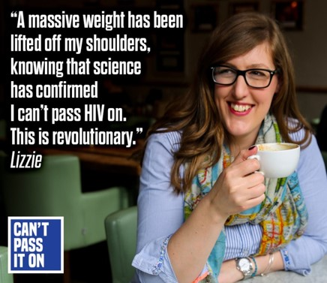
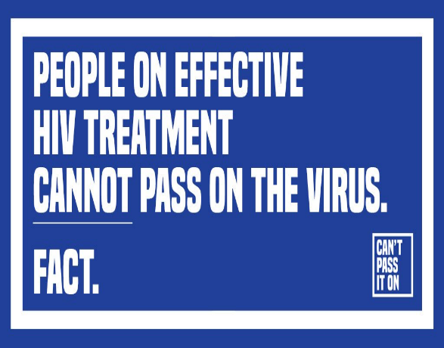
Communicating the message
www.tht.org.uk accessed July 2021

Slide 17
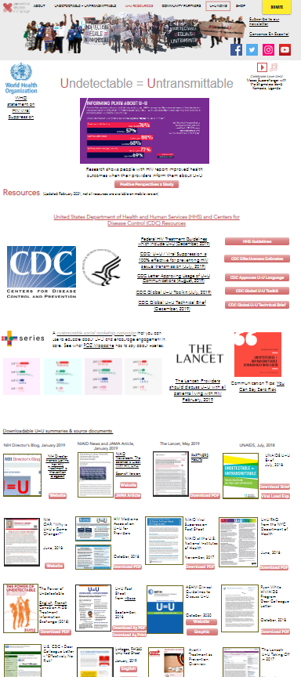
Multiple UK and international resources
Avert via https://www.avert.org/
i-base via https://i-base.info/u-equals-u/
London HIV Prevention Programme - Do It London Via https://doitlondon.org/undetectable/
NAM via https://www.aidsmap.com/
National AIDS Trust (NAT) via https://www.nat.org.uk/
Saving Lives via https://www.savinglivesuk.com/
Prevention Access Campaign global resources
https://www.preventionaccess.org/resources
List not intended to be exhaustive

Slide 18


Slide 19
Communicating the message
Knowledge about HIV (and U=U) remains poor in those not working in HIV
In a survey of 411 staff working at St Bartholomew's Hospital, the Royal London Hospital and Newham Hospital:
The respondents were predominantly nurses (57%), healthcare assistants (19%) and doctors (12%) working in adult medical, surgical and critical care wards, accident & emergency and theatres.
Three-quarters would not be confident discussing HIV status with a patient. A quarter would isolate HIV-positive patients in side-rooms and half thought they should be operated on at the end of the day, due to a risk of contamination.
80% had not heard of U=U.
35% did not think that a person living with HIV can conceive and have children who are HIV negative.
82% said they would like more information and training on HIV
Shongwe M et al. Measuring healthcare HIV knowledge within our NHS Trust. British HIV Association conference, abstract O06, November 2020

Slide 20
Putting this into practice
Communicating U = U with patients

Slide 21
Defining U=U
There is no risk of transmission when someone has been on treatment for 6 months and has an undetectable viral load¹
Rather than…..
There is no risk of transmission when someone is on treatment and has had an undetectable viral load for 6 months
An undetectable viral load is defined as anything < 200 RNA copies/ml²
Mujugira et al. HIV Transmission Risk Persists During the First 6 Months of Antiretroviral Therapy JAIDS, 2016. 15;72(5):579-84
Rodger AJ et al. JAMA 2016;316(2):171–81.

Slide 22
Viral load blips and low level viraemia
There is no risk of transmission as long as the viral load remains below 200 RNA copies/ml¹
Viral load ‘blips’, where the viral load remains below 200 RNA copies/ml, are not a concern for transmission¹
Good adherence is key. As long as that is maintained, people living with HIV can be confident they are maintaining an undetectable viral load.
Detectable viral loads in people established on therapy are not common²
U=U does not apply if the viral load is > 200 RNA copies/ml¹
Rodger AJ et al. JAMA 2016;316(2):171–81
Conner et al. Durability of viral suppression with first-line antiretroviral therapy in patients with HIV in the UK: an observational cohort study. Lancet HIV. 2017;4(7):e295-e302.

Slide 23
Breast Feeding (and other settings)
U = U only applies to sexual transmission
An undetectable viral load makes transmission in other settings rare – but possible
Suppressive maternal antiretroviral therapy significantly reduces, but does not eliminate, the risk of vertical transmission and we currently lack data to apply the U=U statement to breastfeeding.^{1,2,3}
In the UK we recommend that women living with HIV do not breastfeed as there are alternatives^{1.} However – woman can choose to breastfeed if they want to (and should be supported to do so). BHIVA has guidance and patient info on how to do this safely⁴
BHIVA guidelines. https://www.bhiva.org/file/5f1aab1ab9aba/BHIVA-Pregnancy-guidelines-2020-3rd-interim-update.pdf
Shapiro et al Antiretroviral Regimens in Pregnancy and Breast-Feeding in Botswana. N Engl J Med. 2010 Jun 17; 362(24): 2282–2294.
Giuliano et al Maternal Antiretroviral Therapy for the Prevention of Mother-To-Child Transmission of HIV in Malawi: Maternal and Infant Outcomes Two Years after Delivery. PLoS One. 2013; 8(7): e68950. https://journals.plos.org/plosone/article?id=10.1371/journal.pone.0068950
BHIVA guidelines for the management of HIV in pregnancy and postpartum 2018. https://www.bhiva.org/pregnancy-guidelines

Slide 24
What about STIs?
STIs do not increase the risk of transmission in the context of a viral load below 200 RNA copies/ml
In Partner 2: 18% of HIV negative and 27% of HIV positive partners reported STIs and there was still a zero risk of HIV transmission in the context of an undetectable viral load¹.
1. Rodger AJ et al. Risk of HIV transmission through condomless sex in serodifferent gay couples with the HIV-positive partner taking suppressive antiretroviral therapy (PARTNER): final results of a multicentre, prospective, observational study. Lancet 2019 Jun 15;393(10189):2428-2438

Slide 25
The language we use
If you believe it, so will they….
Understanding the message has significant impact for individuals living with HIV
Healthcare professionals need to adopt a consistency of message around U=U
The language we use makes a difference:
Extremely unlikely
Nearly impossible
Close to zero
Helps prevent HIV
-
“Could”
“Might”
“Low risk”
?
Can’t pass it on
Cannot transmit
Zero risk
Prevents HIV
-
“Can’t”
“Won’t”
“No risk”
?
Notes:
Time to challenge the language we use – especially focused on HCPs. The importance of (1) getting the message out and (2) using definitive language confidently

Slide 26

British HIV Association (BHIVA) are clear on U = U
BHIVA statement on U=U
We urge health care professionals to discuss U=U proactively with all people living with HIV at appropriate points during care including, but not limited to:- at diagnosis, when initiating treatment, to encourage adherence, when undetectable, and if planning to conceive.
We recommend consistent and unambiguous terminology when discussing U=U such as "no risk" or "zero risk" of sexual transmission of HIV, avoiding terms like "negligible risk" and "minimal risk."
BHIVA encourages universal promotion of Undetectable=Untransmittable (U=U), via https://www.bhiva.org/BHIVA-encourages-universal-promotion-of-U-U

Slide 27
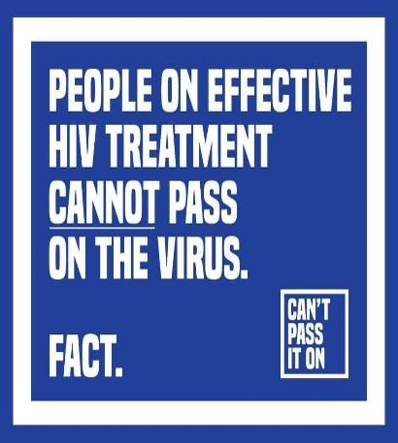
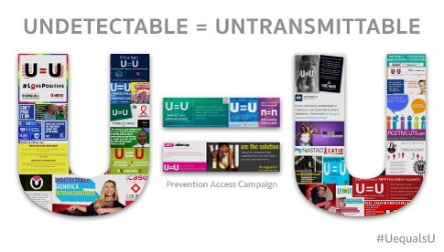
Zero risk, Zero excuses
#CantPassItOn
#UequalsU
www.tht.org.uk accessed July 2021
www.preventionaccess.org accessed July 2021

Slide 28
Any questions?

