Slide 1

The evidence supporting how people living with HIV who have an undetectable viral load can’t pass it on
Prof Alison Rodger

Slide 2
Definitions
Viral load suppression: When a person with HIV has a measured quantitative HIV RNA viral load of <200 copies/mL of blood
Undetectable viral load: When an HIV viral load is below the level of detection on a specific assay, typically HIV RNA <20 copies/mL, but sometimes < 40 or <50 copies/mL
Untransmittable: The finding, proven by clinical trials and observational studies, that people living with HIV who maintain a suppressed/undetectable viral load have so little HIV in their blood and other secretions that they have no risk of passing HIV to others through sex

Slide 3
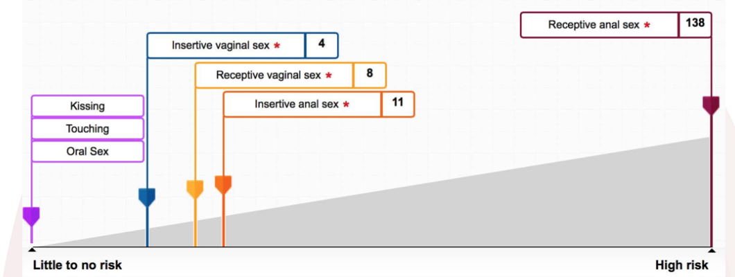
Risk of HIV Transmission:
Per 10,000 Condomless Sex Acts in the Absence of ART
HIV transmission, even without a condom and without ART,
is generally an uncommon event
* Sexual activity without protective factors, such as condoms, PrEP, or ART, and without risk factors, such as sexually transmitted infection (STI) or acute HIV infection
https://wwwn.cdc.gov/hivrisk/estimator.html#+sb. Patel et al (2014). Estimating per-act HIV transmission risk. AIDS, 28(10), 1509-1519
Notes:
Updated with Raleway b

Slide 4
The First Study
Rakai study of 415 HIV serodifferent heterosexual couples in Uganda
All subjects
Male-to-female
transmission
Female-to-Male
transmission
Transmission rate
per 100 person-years
35
30
25
20
15
10
5
0
<400
400–3,499
3,500–9,999
10,000–49,999
≥50,000
<400
400–3,499
3,500–9,999
10,000–49,999
≥50,000
<400
400–3,499
3,500–9,999
10,000–49,999
≥50,000
HIV-1 RNA (copies/ml)
No cases of HIV transmission to sexual partners for PLWH with VL <1,500 copies/mL
.
Quinn TC et al. N Engl J Med 2000;342:921–9.

Slide 5
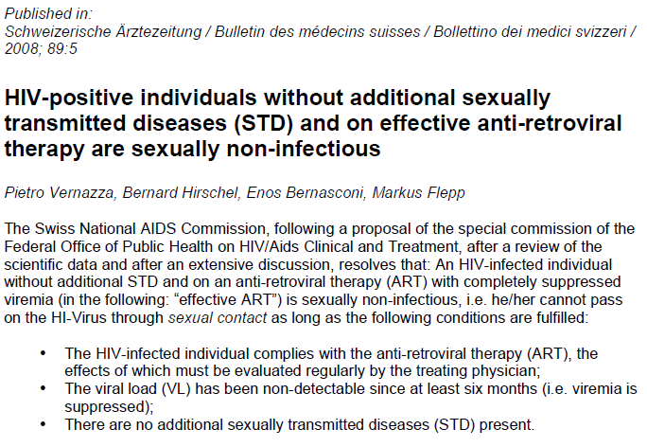
Expert Opinion (2008): The Swiss Statement
Vernazza P, Hirschel B,
Bernasconi E, Flepp M.
Les personnes séropositives ne souffrant d’aucune autre MST et suivant un traitment antirétroviral
efficace ne transmettent pas le VIH par voie sexuelle.
Bull Med Suisses 2008; 89: 165–69.

Slide 6
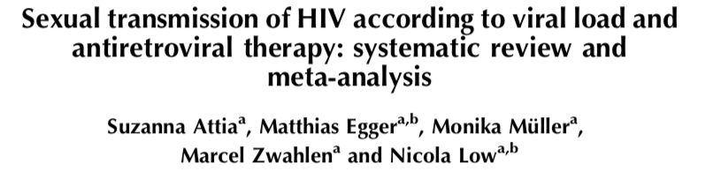
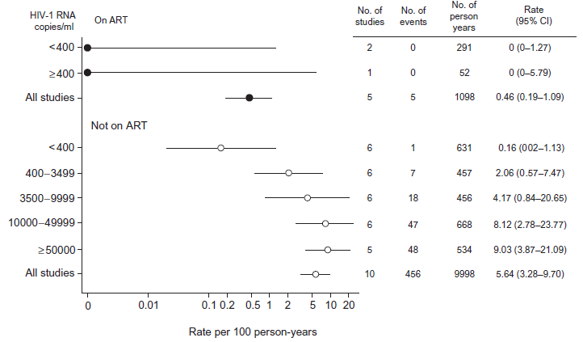
Meta-analysis Heterosexual Studies(2009)
11 cohorts
5021 heterosexual serodifferent couples
92% reduction in transmission on ART: 5.64 to 0.46 per 100PY
Compatible with one transmission per 79PY or 7900 sex acts
WHO view: “there is insufficient evidence
to formulate guidance on the role of ART
in HIV prevention, both at the level of
the individual and the population”
AIDS. 2009. 23:1397-1404

Slide 7
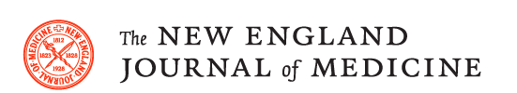

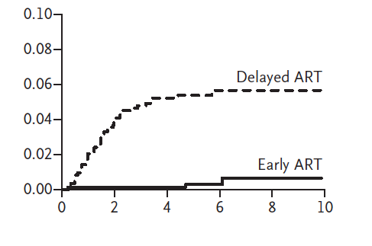

Finally, an RCT…
HIV Prevention Trial Network (HPTN) 052
Risk of HIV-1 infection
among partners of index participants
HR=0.07 (0.02-0.22)
“Early ART at enrollment [CD4+ count 350 to 550 cells] was associated with a 93% lower risk of linked partner infection than was delayed ART (CD4+ fell to <250)”
Cohen M et al. (2016) Antiretroviral Therapy for the Prevention of HIV-1 Transmission. N Engl J Med, 375:830–9.

Slide 8
Finally, an RCT…
HIV Prevention Trial Network (HPTN) 052
Risk of HIV-1 infection
among partners of index participants
HR=0.07 (0.02-0.22)
“Early ART at enrollment [CD4+ count 350 to 550 cells] was associated with a 93% lower risk of linked partner infection than was delayed ART (CD4+ fell to <250)”
v
On ART<1 week
Viral load not suppressed
ART failure
Viral load not suppressed
100% reduction in transmission if VL<200 copies/mL
Cohen M et al. (2016) Antiretroviral Therapy for the Prevention of HIV-1 Transmission. N Engl J Med, 375:830–9.

Slide 9
Why do the PARTNER Study?
There is evidence in heterosexual couples of the reduced risk of HIV transmission from condomless sex with suppressive ART
In HPTN 052 only 2% (n=37) were MSM couples so along with other studies gave no direct evidence for anal as opposed to vaginal sex
Condom use also effectively prevents HIV transmission and cumulative CYFU from all studies with CLS is only around 330 CYFU
Uncertainty of upper limit of the estimates if no transmissions - not the same as zero chance of transmission
Rodger et al. Antivir Ther. 2013;18(3):285-7, Cohen et al. N Engl J Med. 2011; 365:493–5052.

Slide 10

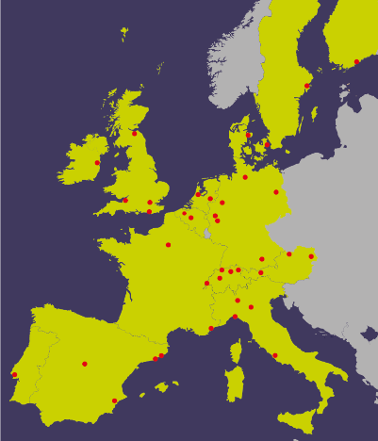

PARTNER Study
(Partners of people on ART:a New Evaluation of the Risks)
Design: an observational multi-centre European study of
HIV serodifferent couples (gay and heterosexual)
in which the positive partner is on ART
PARTNER1: 2010-2014 (gay and heterosexual)
PARTNER2: 2014-2018 (gay couples only)
Primary Study Aim
To assess HIV transmission risk through condomless sex where the HIV-positive partner is on ART with a plasma HIV-1 RNA load <200 copies/mL
National Institute for Health Research (NIHR) funded research:
Programme Grant for Applied Research scheme (RP-PG-0608-10142) and RfPB scheme (PB-PG-1013-32069)

Slide 11
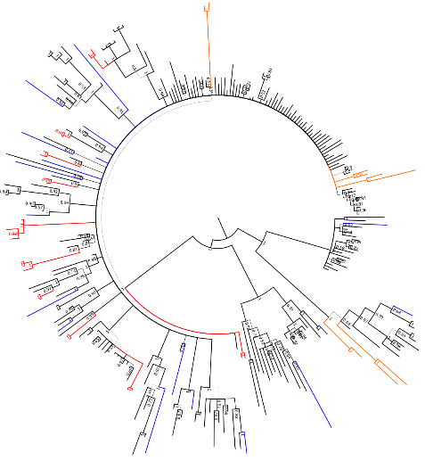
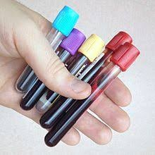
Study Procedures
Couple years of follow-up between HIV tests were included:
  Couples had condomless sex together
  No PEP or PrEP use by the HIV negative partner
  HIV-1 RNA load <200 copies/mL in HIV + partner
We reported rate of within-couple phylogenetically linked transmissions during eligible CYFU
Partners
Partner Controls
Transmission Controls
If a HIV-­‐negative partner became HIV-­‐positive, a venous blood sample was taken from both partners to determine genetic relatedness of the respective HIV sequences
Partner on suppressive ART
Newly positive partner
HIV-­‐1 DNA from PBMC
HIV-­‐1 RNA from plasma

Slide 12
Sequencing and Phylogenetic Analysis
HIV-1 pol and env sequences were obtained from either plasma or PBMCs by Sanger sequencing, complemented by deep sequencing by Illumina in a subset
Maximum likelihood (ML) and Bayesian Markov Chain Monte-Carlo (MCMC) inferences were determined with RAxML-HCP2 v8 and Mr Bayes v3.2.6, respectively
Controls: i) the 10 closest GenBank sequences, ii) replicate
partners’ sequences, and iii) sequences from confirmed HIV- transmission pairs
Criteria for linking infections was monophyletic clustering with high statistical support e.g bootstrap value ≥0.90 (ML) or a posterior probability ≥0.95 (MCMC), and a pairwise genetic distance of ≤0.015 nucleotide substitutions per pol site
Rodger et al. JAMA, 2016. Geretti et al, JAMA, 2016. Beloukas et al. Virus Res, 2012.

Slide 13
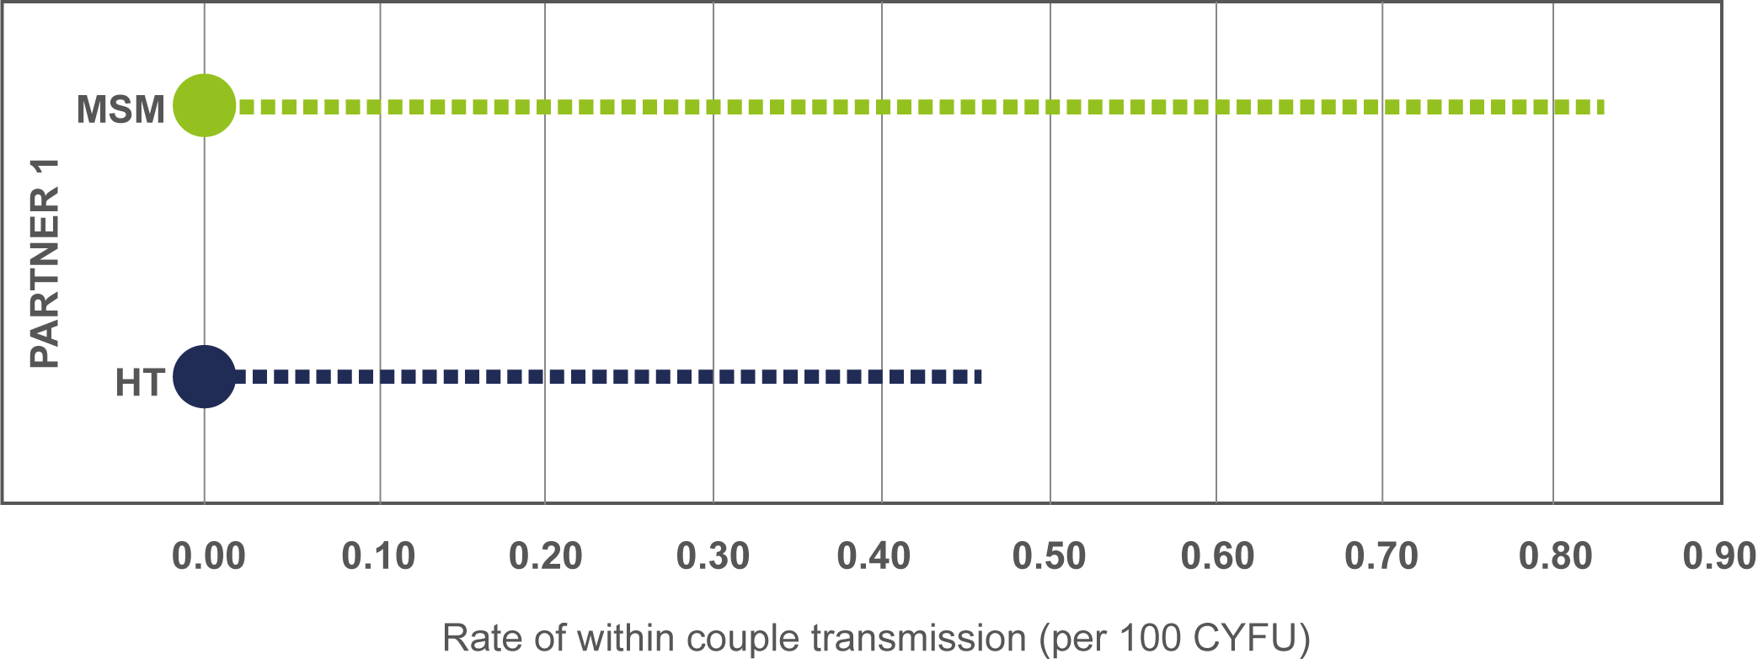
PARTNER1 Study Results
1,238
eligible CYFU (1/3 gay couples)
58,000
condomless sex acts
ZERO
transmissions phylogenetically linked to HIV positive partner
Zero transmissions for both heterosexual and gay couples.
But, PARTNER1 was not a large enough study in gay men to be really sure of the accuracy of the result
Upper limit: one transmission after 119 years CLS
Upper limit: one transmission after 217 years CLS

Slide 14
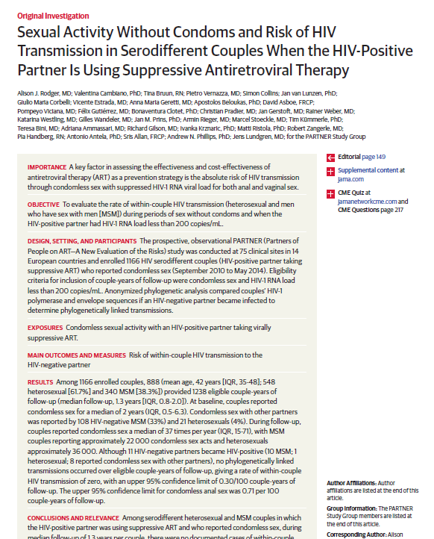

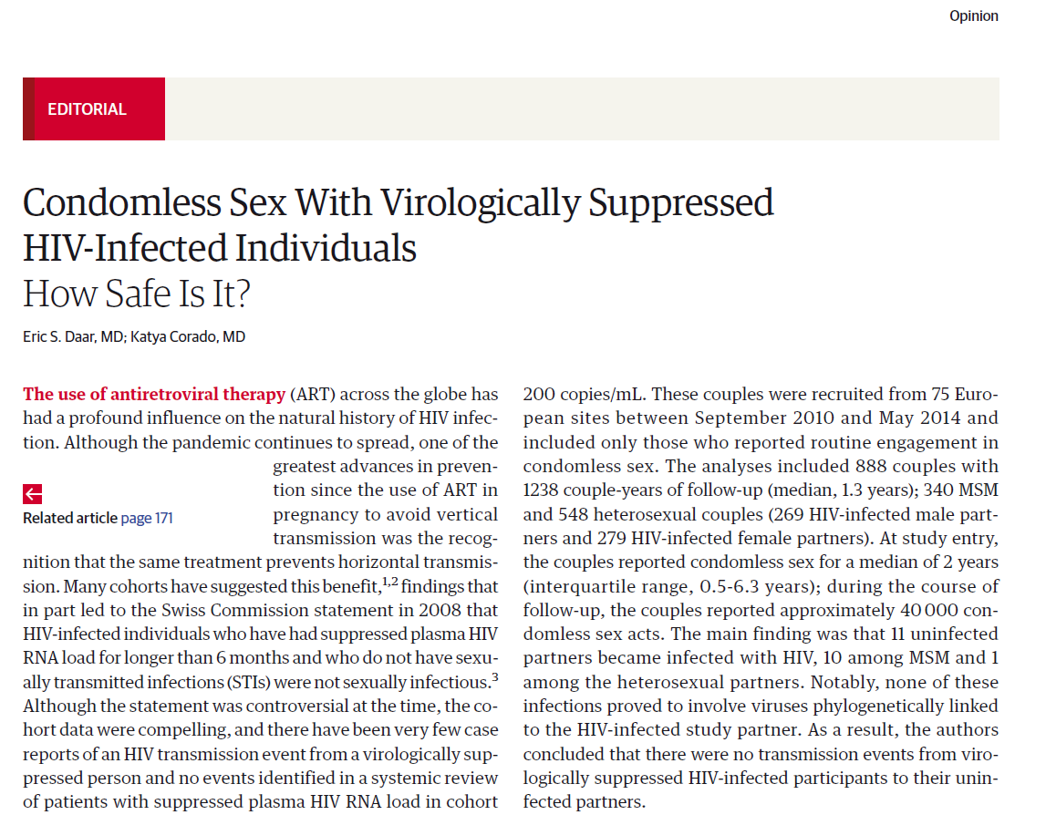
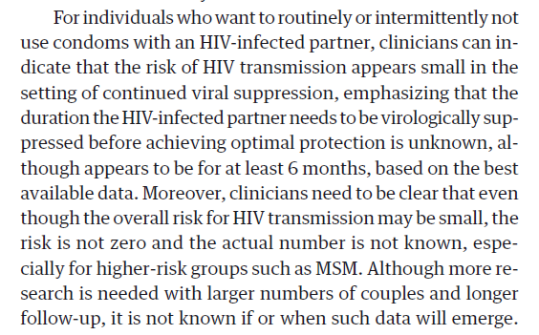

Slide 15
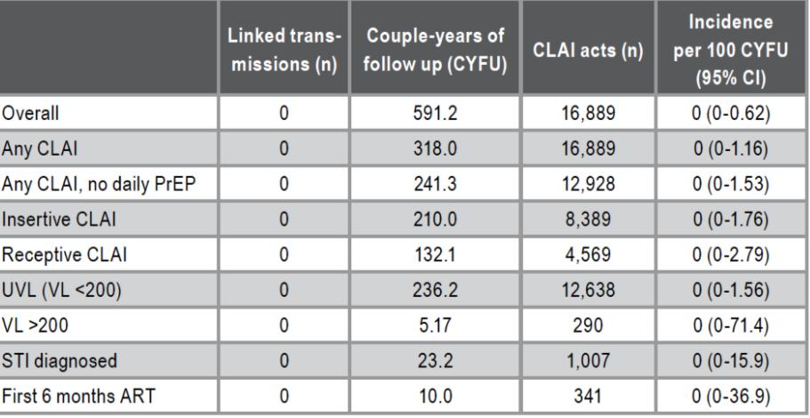

The Opposites Attract Study
343 serodifferent gay couples
HIV+ partner suppressed on ART
12,928 condomless anal sex acts, no PrEP
No HIV transmissions from primary partner
3 transmissions from other partners outside of study
CLAI, condomless anal intercourse; UVL, undetectable viral load
Bavinton BR et al. Lancet HIV. 2018;5(8):e438-e447

Slide 16


Final piece of the jigsaw….
“HIV transmission risk through condomless sex in gay couples with suppressive ART: The PARTNER2 Study extended results in gay men”

Slide 17
PARTNER2 Study Results
1,596
eligible CYFU from gay couples
At study entry
Age, median (IQR, n=759) | 38 (31-45)
White ethnicity (%, n=768) | 687 (89%)
During follow up
Years in the study, median (IQR) | 1.6 (0.9-2.9)
Diagnosed with STI, % | 23%
Condomless sex with other partners, % | 37%
Condomless sex per year, median (IQR) | 43 (19-74)
Estimated total number condomless sex acts | 76,940
77,000
condomless sex acts
Notes:
The way you had the red boxes appear on the film were correct.

Slide 18
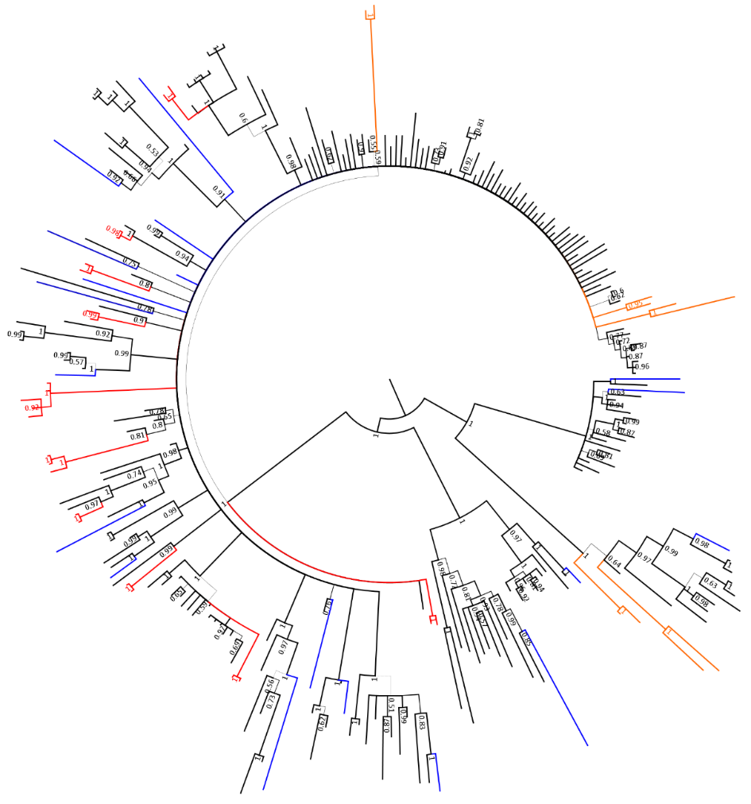
Phylogenetic tree of pol subtype B sequences
Partners
Partner Controls
Transmission Controls
The 15 HIV-positive partners all had subtype B infection; 6 of the 15 seroconverting partners acquired non-B infections
None of the partners’ sequences (blue) clustered together
The study partner controls (red) and the control sequences from confirmed transmission pairs (orange) always clustered together with high supports
The controls pairwise genetic distance was 0.004 (IQR: <0.001, 0.007), whilst the partners’ pol sequences showed a median pairwise genetic distance of 0.068 (IQR: 0.060, 0.086).

Slide 19
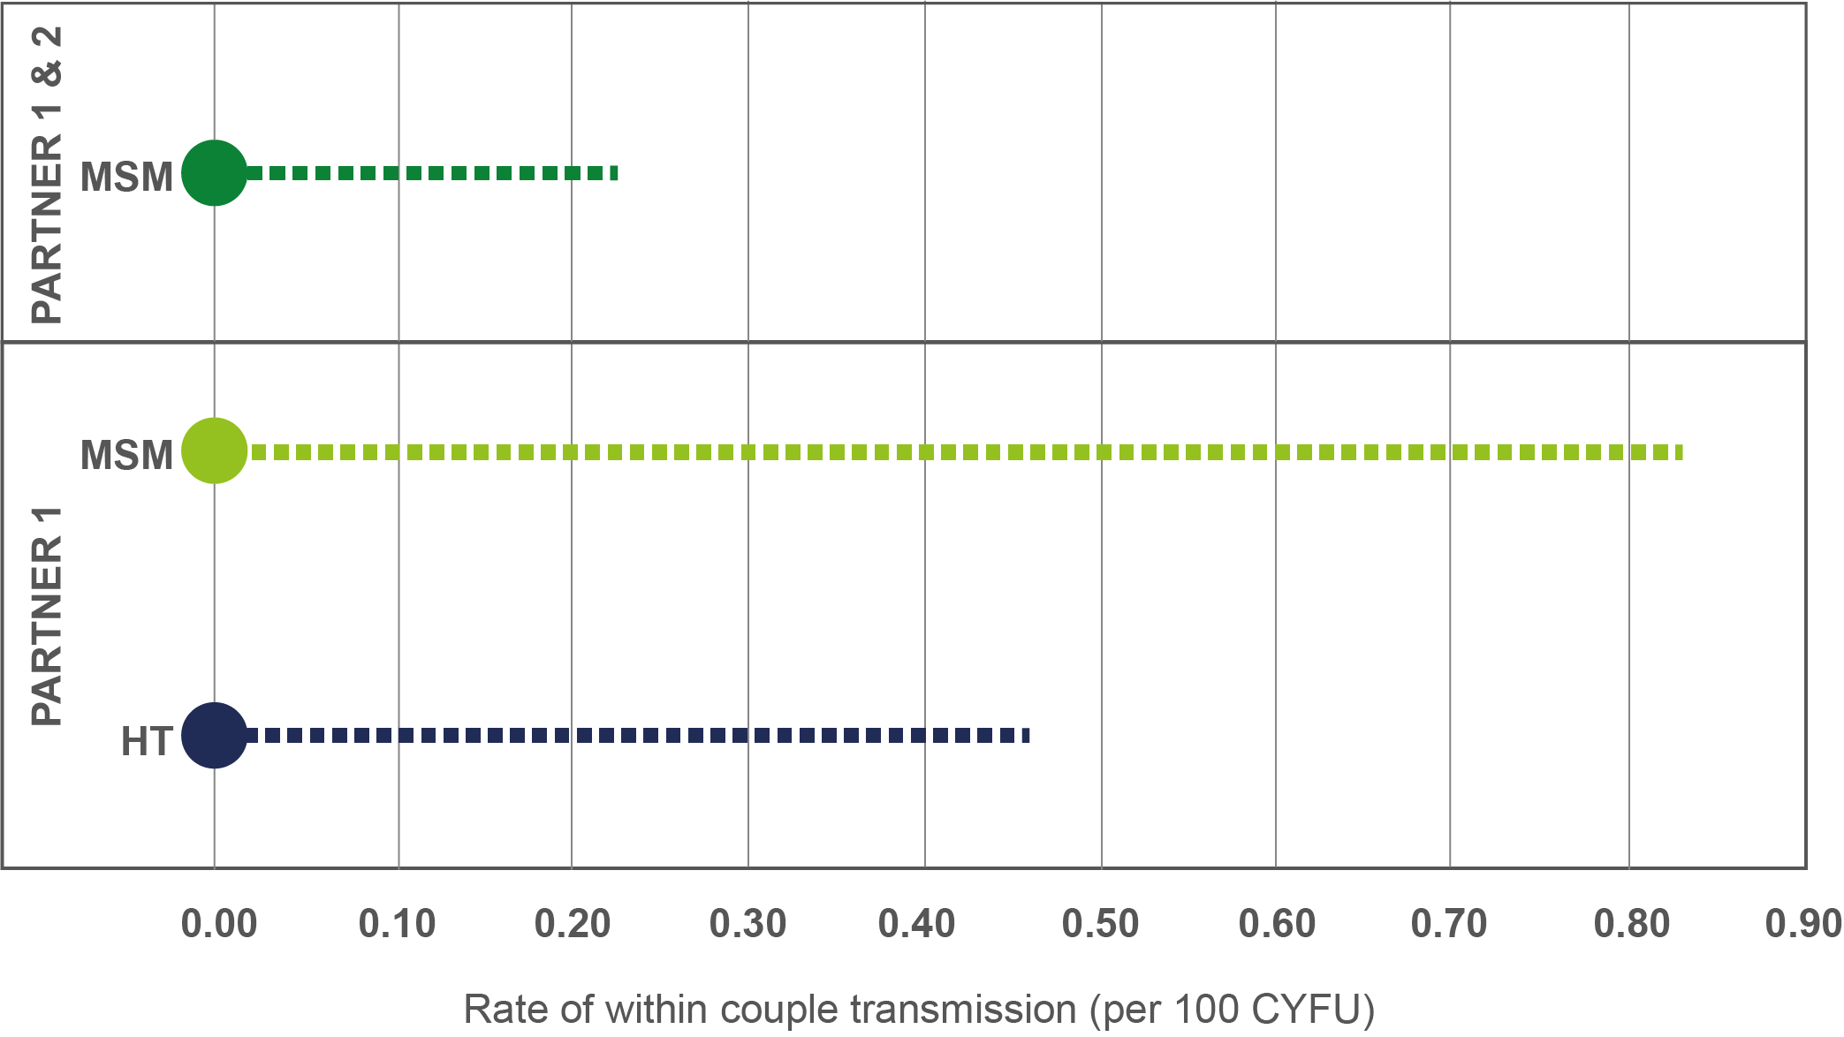
PARTNER Study
Upper 95% CI around rate of zero HIV transmissions:
PARTNER 1
Upper limit: one transmission after 119 years CLS
Upper limit: one transmission after 217 years CLS

Slide 20
PARTNER Study
Upper 95% CI around rate of zero HIV transmissions:
PARTNER 1 compared to PARTNER 2
Upper limit: one transmission after 435 years CLS
Upper limit: one transmission after 119 years CLS
Upper limit: one transmission after 217 years CLS

Slide 21
How does the evidence for U=U weigh up?
There is zero evidence that HIV transmission is actually possible with a suppressed viral load
Observational Studies
Quinn et al (2000) n=415 HT
Castilla et al (2005), n=393 HT
Melo et al (2008) n=93 HT
Donnel et al (2010), n=349 HT
Reynolds et al (2011), n=250 HT
Rodger et al (2016), n= 548 HT, 380 MSM
Bavinton et al (2017), n=343 MSM
Rodger et al (2018), n=972
RCTs
Cohen et al (2016), n= 903 HT

Slide 22
Yes, but….

Slide 23
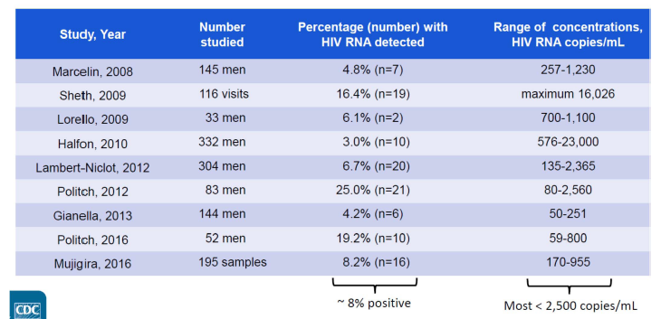
What about genital shedding?
Seminal HIV-RNA load is correlated strongly with blood HIV-RNA load
HIV RNA in semen detected in
6–8% of men with suppressed HIV-1 RNA in blood even in absence of STIs
Most seminal VL is low level <2,500 copies/mL

Slide 24
What about genital shedding?
Low level HIV RNA in semen does not correlate with a risk of HIV transmission if plasma VL supressed
HIV detected in semen is either defective, not replication competent or does not reach a concentration required for transmission
Seminal shedding also at very low level with 2D regimes (DTG+3TC)
Participants in the many transmission studies would have had intermittent shedding with ZERO transmissions
HIV-1 RNA level in seminal plasma compared with detection of HIV-1 by mixed lymphocyte co-culture of seminal cell pellet
Coombs et al. Association between culturable HIV-1 in semen and HIV RNA levels in semen and blood. J Infect Dis. 1998;177(2):320-30.
Gianella et al. Genital HIV shedding With Dolutegravir (DTG) Plus Lamivudine (3TC) Dual Therapy. JAIDS. 2018 Dec 15;79(5):e112-e114.

Slide 25
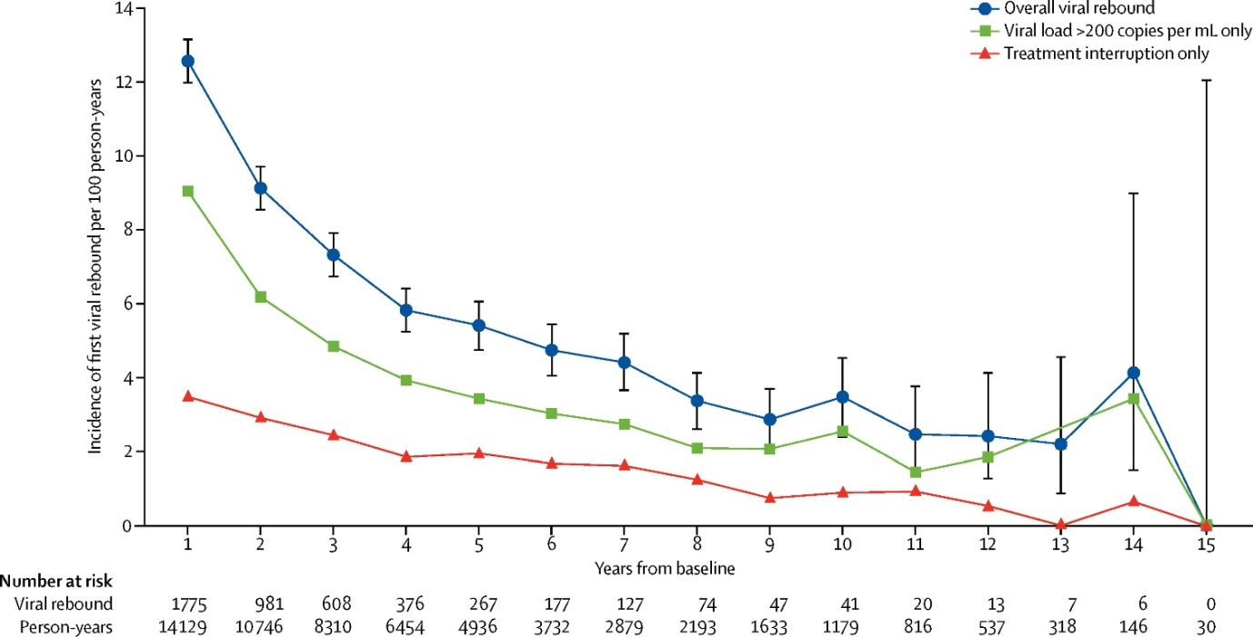
What about viral load rebounds or blips?
U=U is only easy to apply when PLWH have access to testing, effective treatment, viral load monitoring, and support to reach and maintain viral suppression
In these circumstances, such as in the UK, risk of VL rebound is very low
UK CHIC data: rate of rebound, <1% per year in MSM> 45 years (29% rebounds were temporary)
Incidence of first viral rebound by time since study baseline
(9 months after start of ART)
Conner et al.. Lancet HIV. 2017;4(7):e295-e302.

Slide 26

In the UK, 97% of PLWH are on ART,
and 97% of those on ART
are virally suppressed

Slide 27
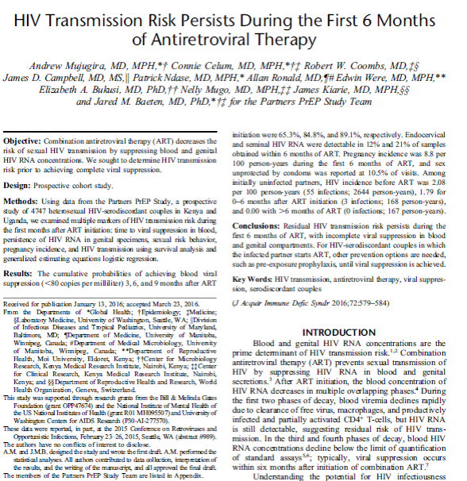
Does U=U apply in the first 6 months on ART once suppressed in blood?
HIV incidence rate
Not on ART: 2.08/100 PY (55 transmissions)
During first 6 months of ART: 1.79/100 PY (3 transmissions)
ART > 6 months: 0/100 PY (no transmissions)
But…. all three transmissions on ART in first 6 months occurred when the HIV positive partners had detectable blood HIV RNA (>200 copies/ml)
Mujugira et al. JAIDS, 2016. 15;72(5):579-84, Gutierrez-Valencia et al, CID 2017:65

Slide 28
Does U=U apply in the first 6 months on ART once suppressed in blood?
The real question in early ART is ‘does genital suppression lag behind blood VL suppression?’
RPV: EVG/cob: DRV/rtv similar patterns of viral decay in blood and semen, initial rapid decline (first phase) followed by a slower second phase
In semen both RPV and EVGcobi mirror the reduction in VL in blood, achieving an undetectable VL in semen faster than DRV/rtv
Once plasma VL is undetectable
genital shedding is minimal
Mean viral decay, by each of the “third” antiretroviral drugs
Mean B HIV-RNA log10 copies/ml
Blood
RPV Rilpivirine
EVGcobi Elvitegravir/cobicistat
DRVrtv Darunavir/ritonavir
Semen
Gutierrez-Valencia et al, CID 2017:65
Notes:
CHECK THIS ONE WITH MICHAEL AND AR

Slide 29
“The concept of U=U is the foundation of being able to end the epidemic”
Dr Fauci, NIAID, July, 2019

Slide 30

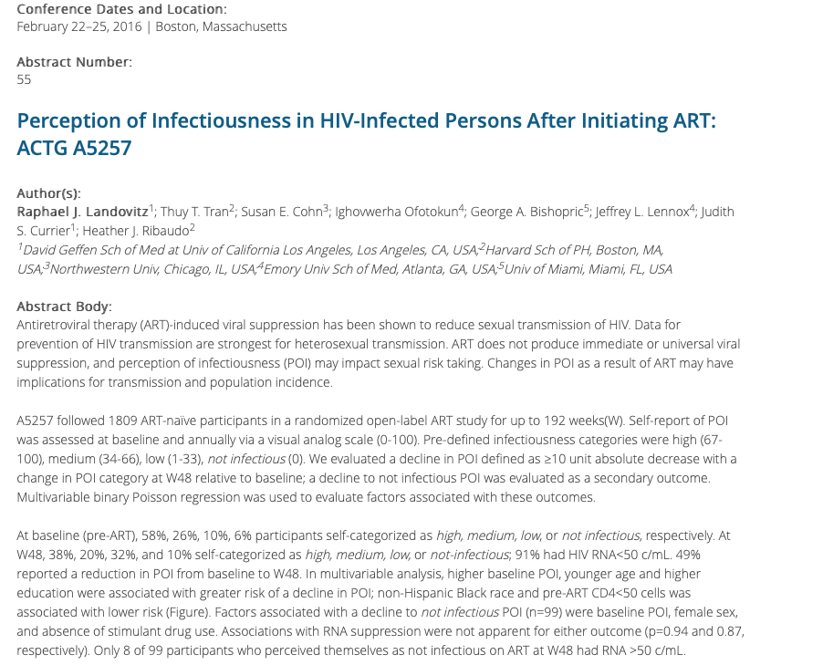
6 years after the Swiss Statement, 3 years after 052 interim results, 1 year after PARTNER interim results…
Week 48, 91% had HIV RNA<50 c/mL
38% self-categorised themselves as highly infectious and 20% as of medium infectivity.
Only 10% thought they were not-infectious.
Notes:
Have moved the box to where she has it on another version of this presentation but on the other veriosn it seems to fill the slide better see notes

